Slide 1

Measuring Roots With Soft Tissue X-ray Imaging
Dan McDonald
President and Co-founder
Phenotype Screening Corporation

Slide 2
OUTLINE
What is soft-tissue X-ray imaging?
How is soft-tissue X-ray imaging used to image roots?
How are root traits quantified from X-ray images?
How is soft-tissue X-ray imaging of roots being used to answer important issues in yield improvement and sustainability?
Can soft-tissue X-ray imaging results be used in crop optimization modeling and decision tools?

Slide 3
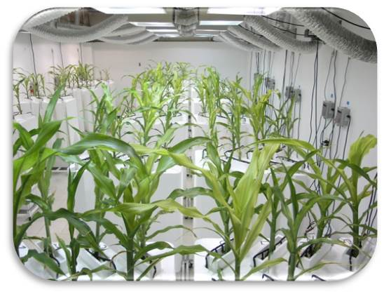
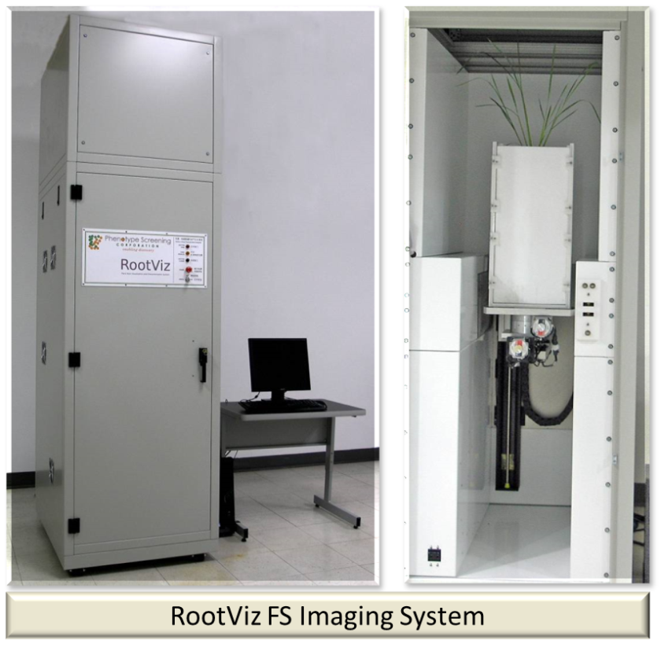
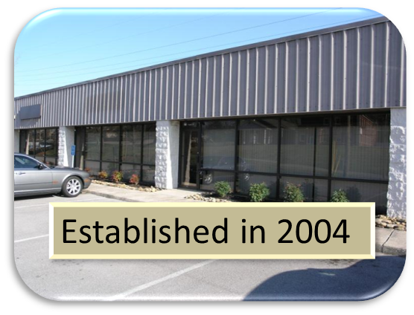
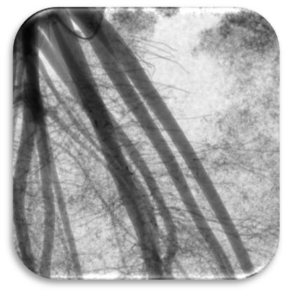
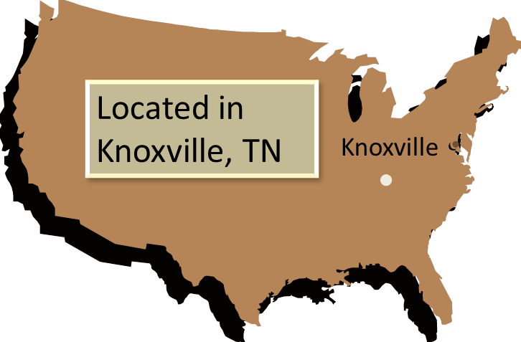

About Us
Root Lab

Slide 4
About Us
We focus on problems whose solutions are worth tens to hundreds of millions of dollars.
Root Lab

Slide 5
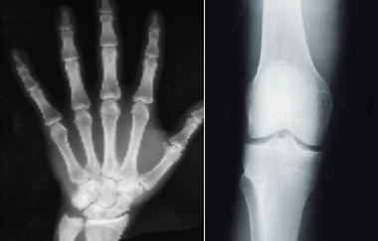
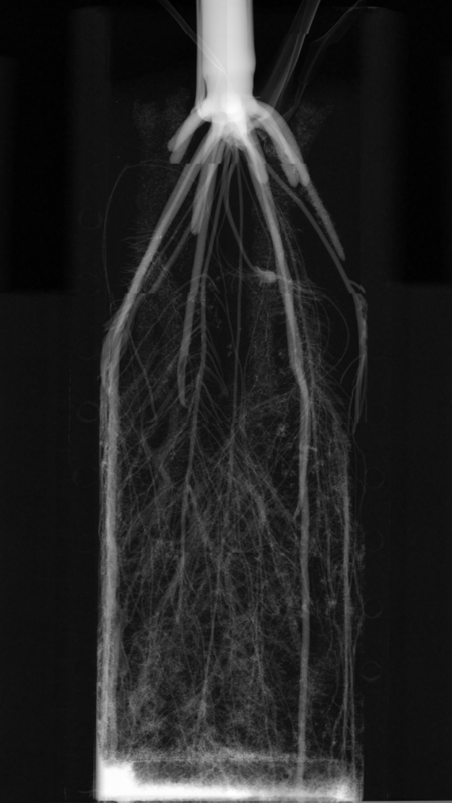
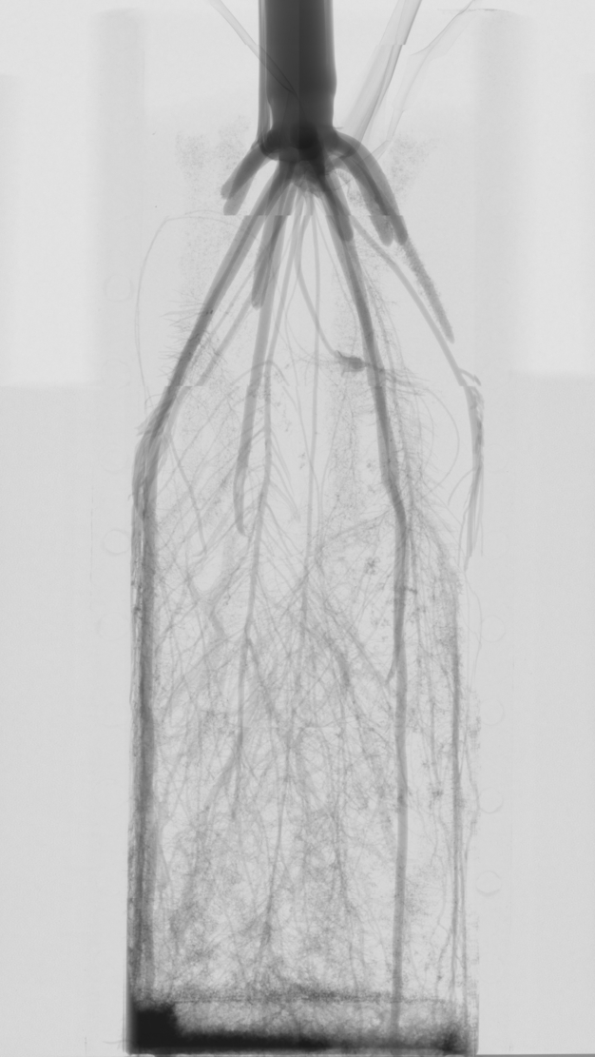
What is Soft-tissue X-ray Imaging?
Medical X-ray Imaging
Soft-tissue X-ray Imaging

Slide 6
Field Harvested Roots Can Be Complicated to Analyze

Slide 7
Our Basic X-ray Imaging Concept
X-ray Generator
X-ray Camera
Very low energy X-rays
(10Kev) allow for soft-tissue imaging.

Slide 8
How is Soft-tissue X-ray Imaging of
Root Systems Accomplished?
X-ray Generator
X-ray Camera

Slide 9
How is Soft-tissue X-ray Imaging Accomplished?
X-ray Generator
X-ray Camera

Slide 10
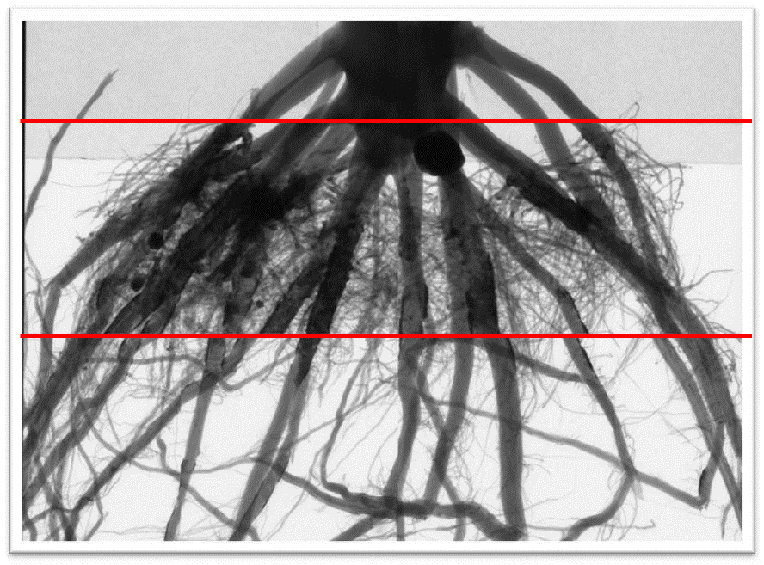
Why Use Soft-tissue X-ray Imaging to Study Plant Roots?

Slide 11
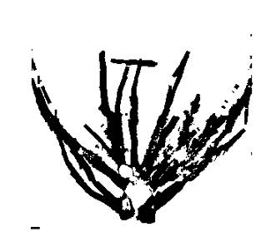
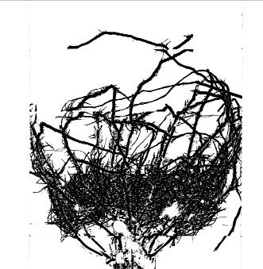
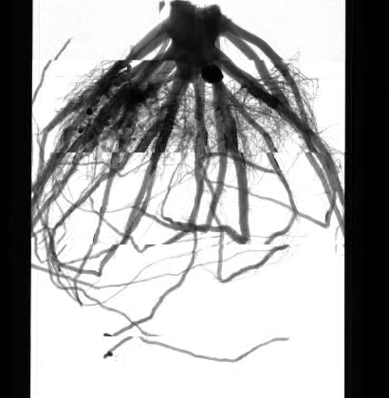
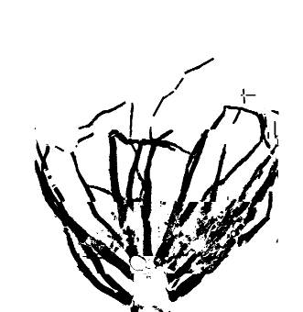
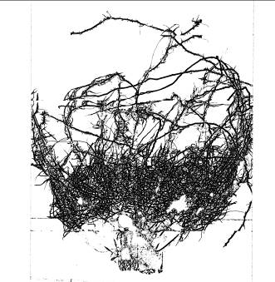
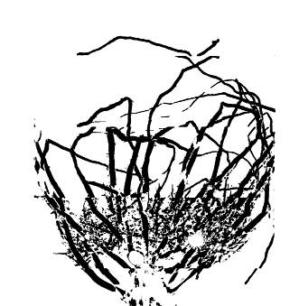
Roots Are Quantified From Soft-tissue X-ray Images
Roots > 2.9mm
By Root Diameter Range
0.362mm < Roots < 2.54mm
1.45mm < Roots < 10.15mm
Original X-ray Image H3Rep1
0.181mm < Roots < 1.27mm
0.725mm < Roots < 5.075mm

Slide 12
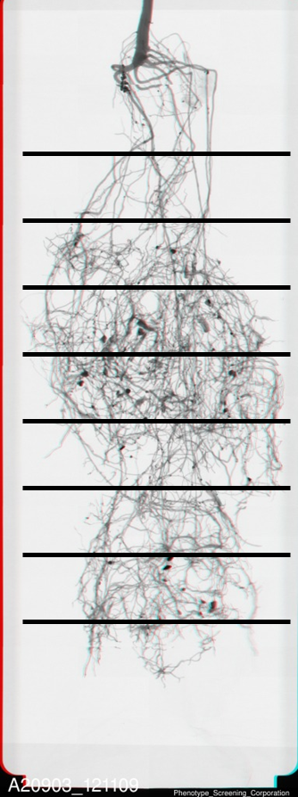


Quantification By Root Depth
  Number of Root Crossings
  Diameter of Root Segments
  Location of Root Segment
  Width of Root System
  Root Crossing Density
By Root Diameter Range
Cotton Roots

Slide 13
Key Root System Architecture Traits
Global Traits
  Projected Root Area
  Total Root Length/ Total Root Length Density
  Number of Root / Transect Crossings
Depth Traits
  Number of Root Crossings
  Diameter of Root Segments
  Location of Root Segment
  Width of Root System
  Root System Density
By Root Diameter Range

Slide 14
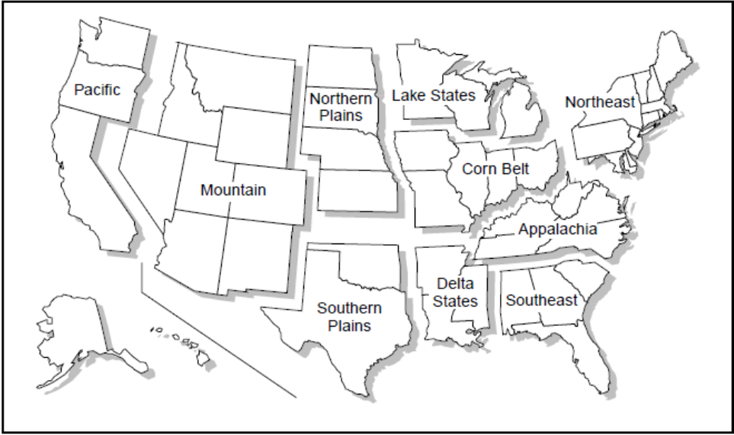
How Is Soft-tissue X-ray Imaging Used to Study Field Harvested Roots?
Production Regions

Slide 15
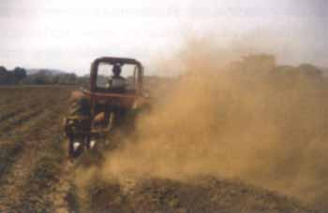
How Is Soft-tissue X-ray Imaging Used to Study Field Harvested Roots?
Production Regions
Tillage Conditions

Slide 16
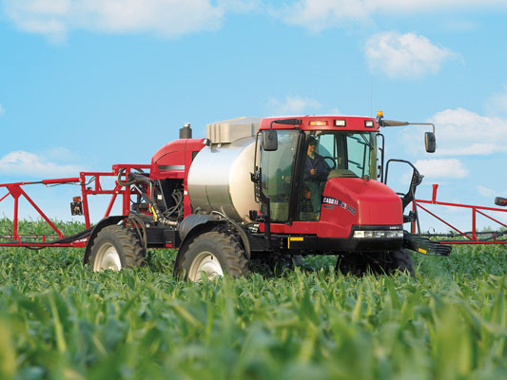
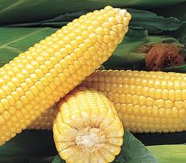
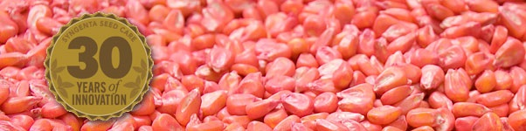
How Is Soft-tissue X-ray Imaging Used to Study Field Harvested Roots?
Foliar Spray
Germplasm Traits
Seed Treatments
Production Regions
Tillage Conditions
Treatment Systems

Slide 17
Production Regions Did Affect Root Traits
Corn Belt Appalachia
Corn Belt Appalachia
Production Regions
No-Till, R1
Corn Belt Appalachia
Corn Belt Appalachia

Slide 18
Tillage Conditions Affect Root Traits
Analysis Across Regions
  Size Class Two; 1,450u - 4,930u
  The three tillage types had significant effects on roots of this size. Strip-till favors roots of this size while no-till does not.
  Size Class Three 725u - 2,465u
  Only no-till had a significant effect on roots of this size. No-till does not favor roots of this size.

Slide 19
Treatment Systems Did Effect Root Traits
CPM TPM APM
CPM TPM APM
Appalachia
No-till, R1
CPM TPM APM
CPM TPM APM

Slide 20
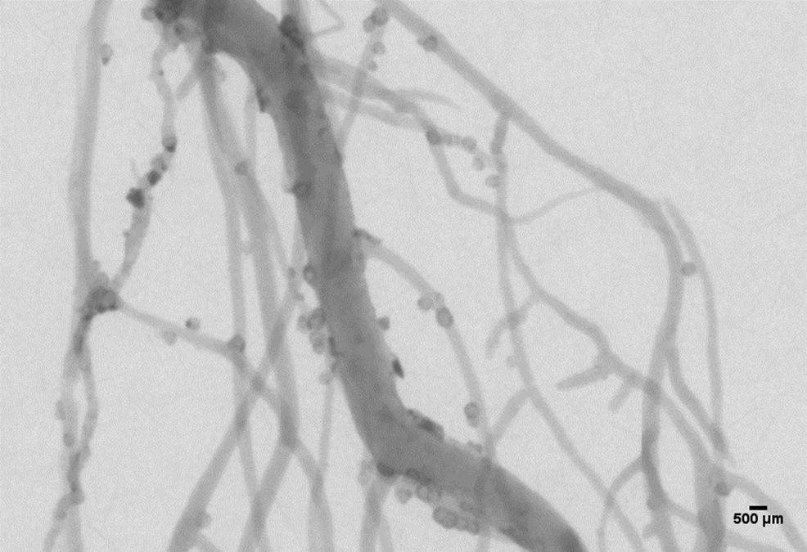
Soft-tissue X-ray Imaging Is Used For Nematode Resistance Screening
Cotton/Reniform NemaTode

Slide 21
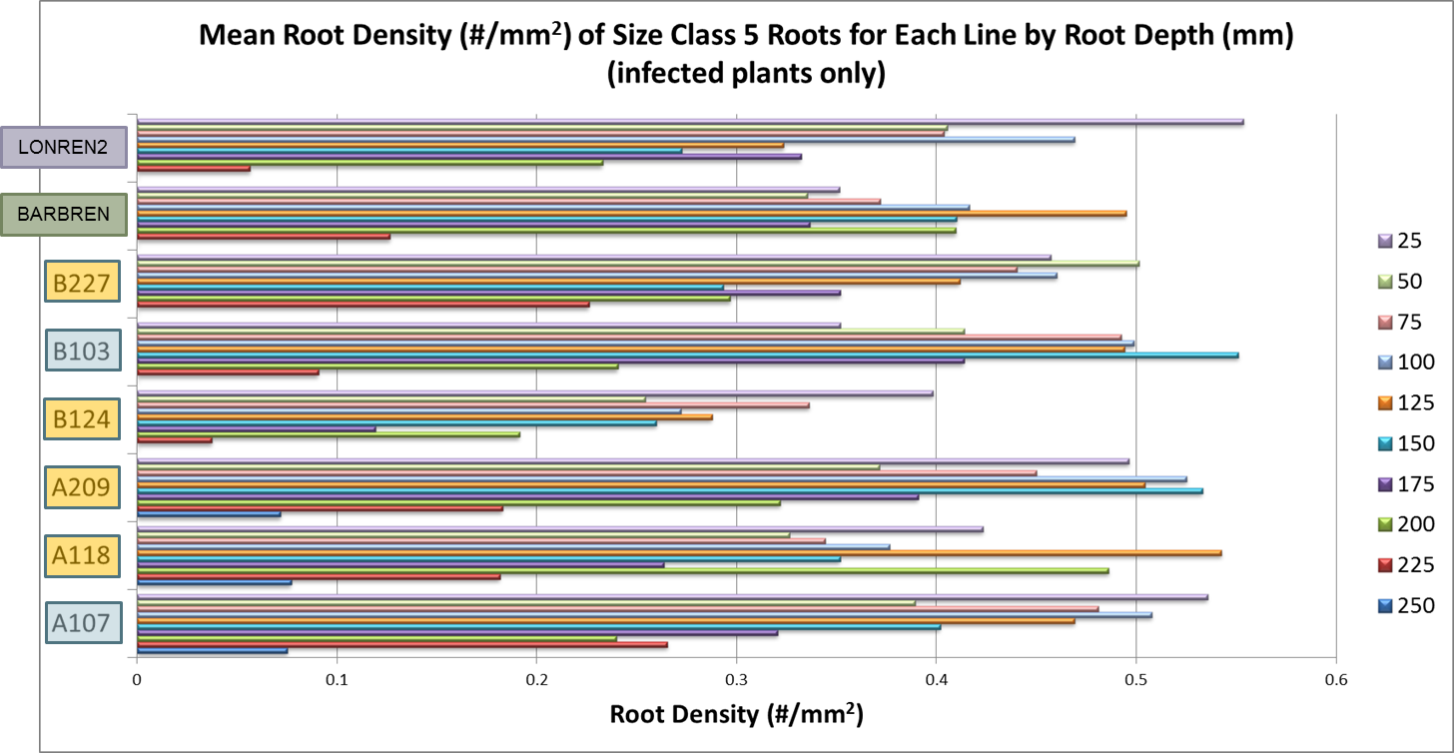
Root Density vs. Depth of Cotton Plants
Cotton/Reniform NemaTode

Slide 22
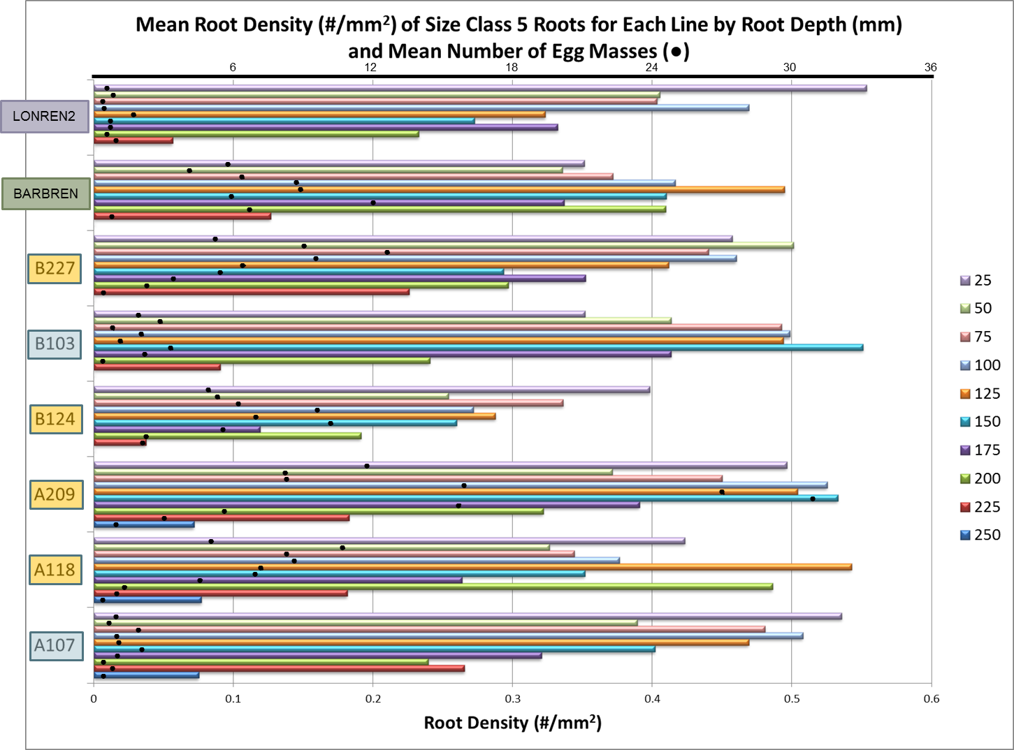
Root Density & Egg Mass Count vs. Depth
Cotton/Reniform NemaTode

Slide 23
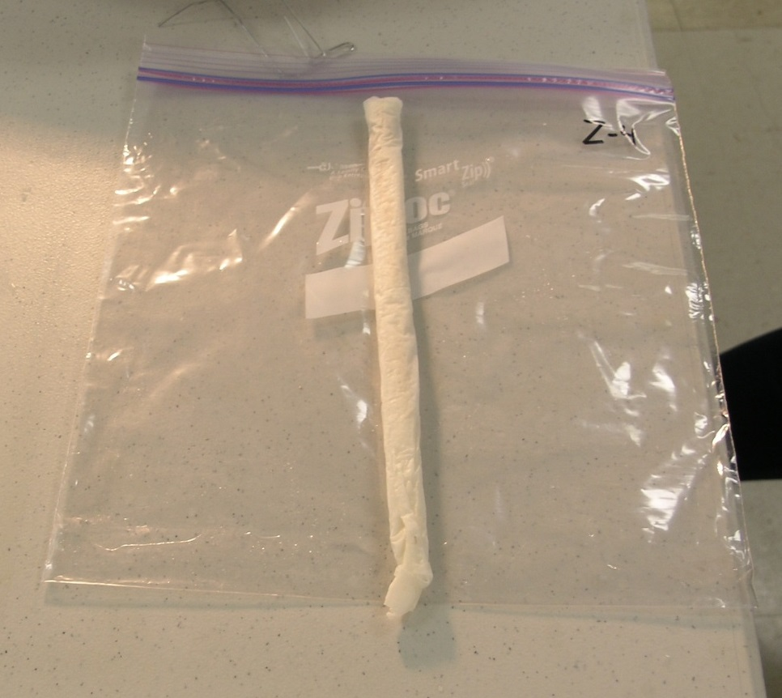
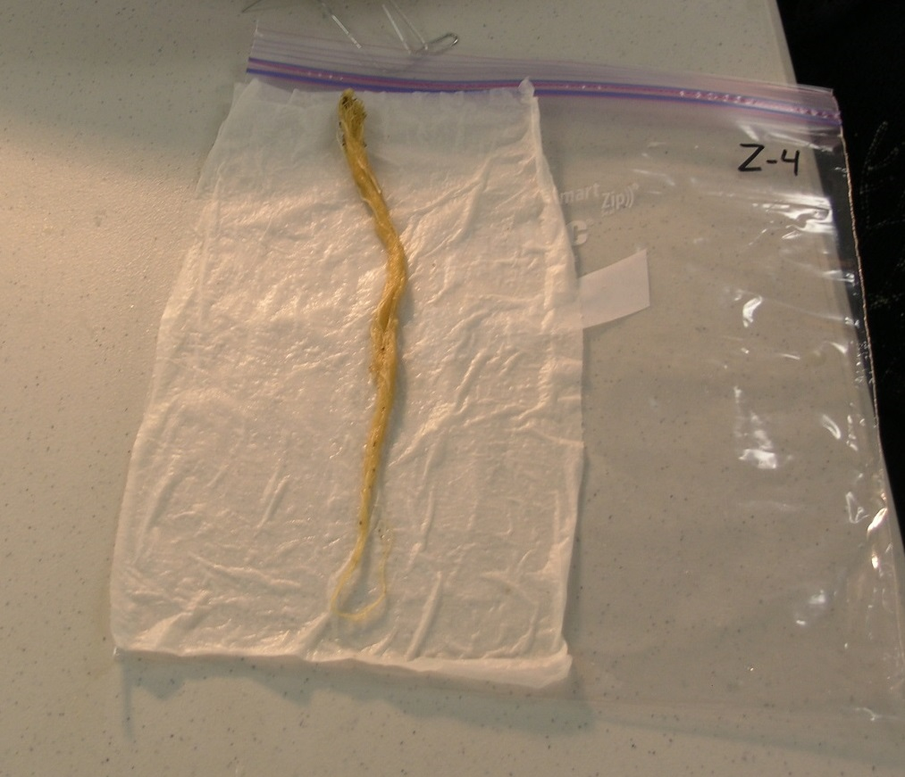
Sometimes Manual Intervention is Required to Achieve Good Images
Rolled Washed Roots of Wheat Seedling

Slide 24
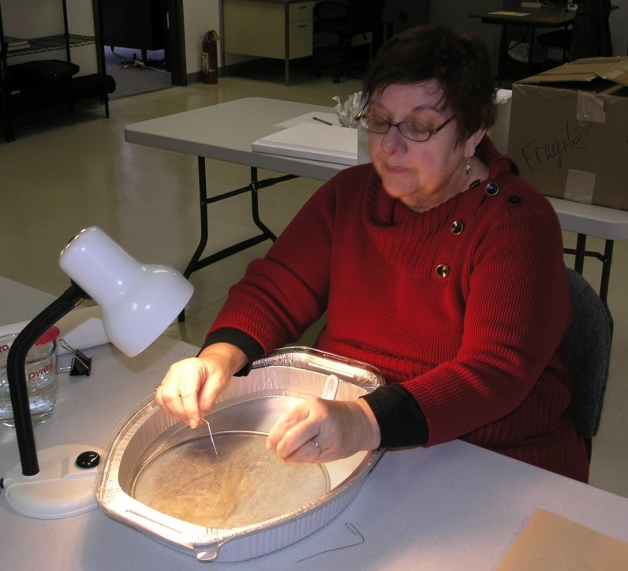
Sometimes Manual Intervention is Required to Achieve Good Images

Slide 25
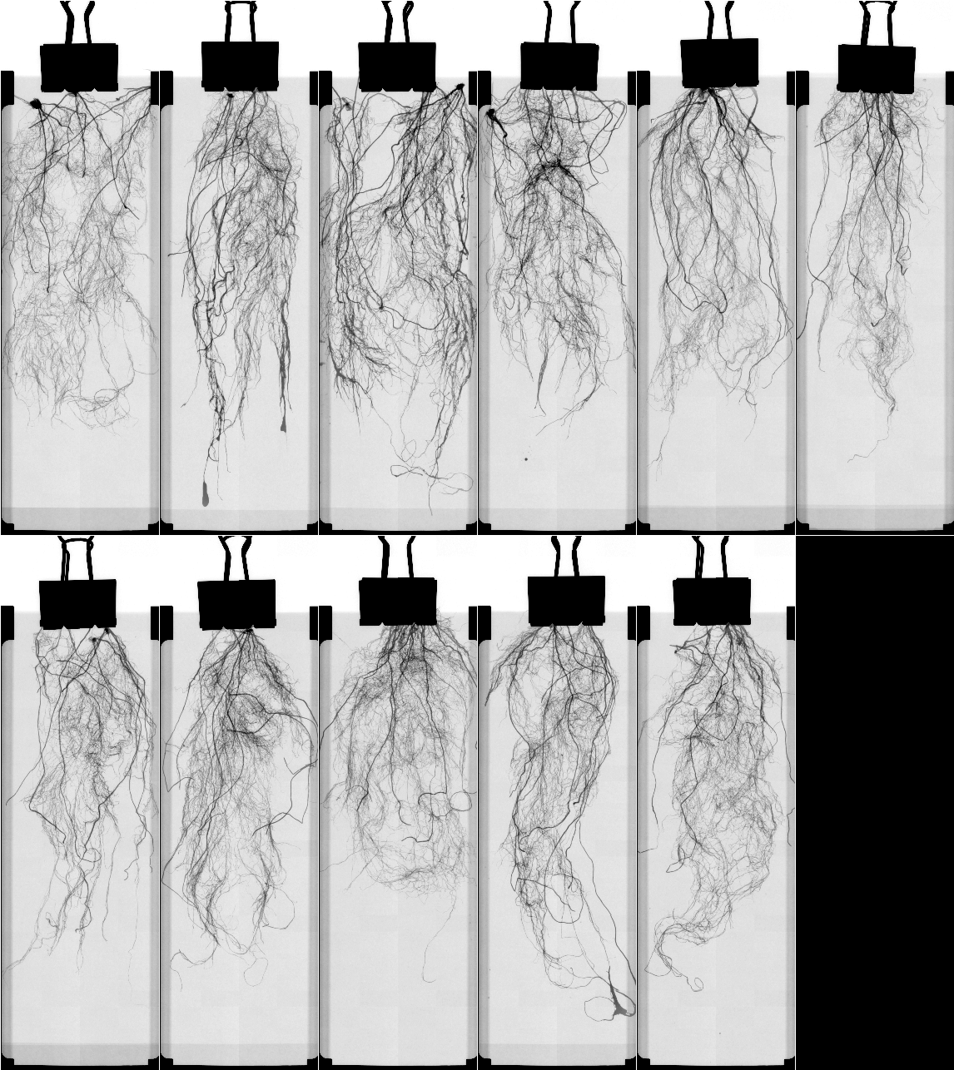
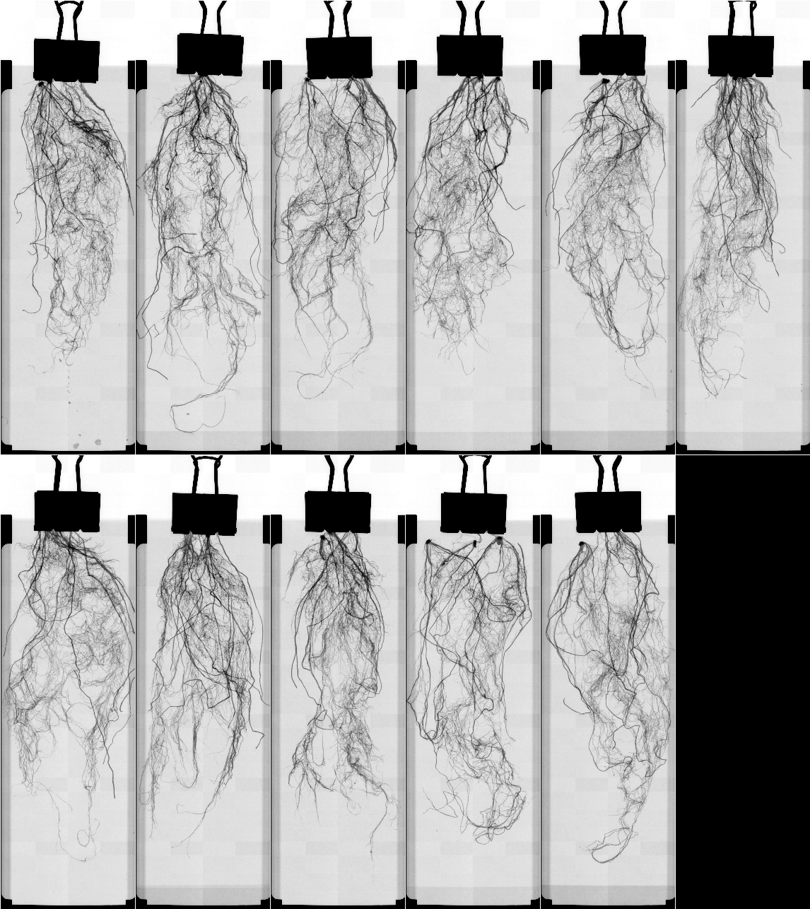
Effect of Microbials on Wheat Seedlings
Formulation X
Formulation Y

Slide 26
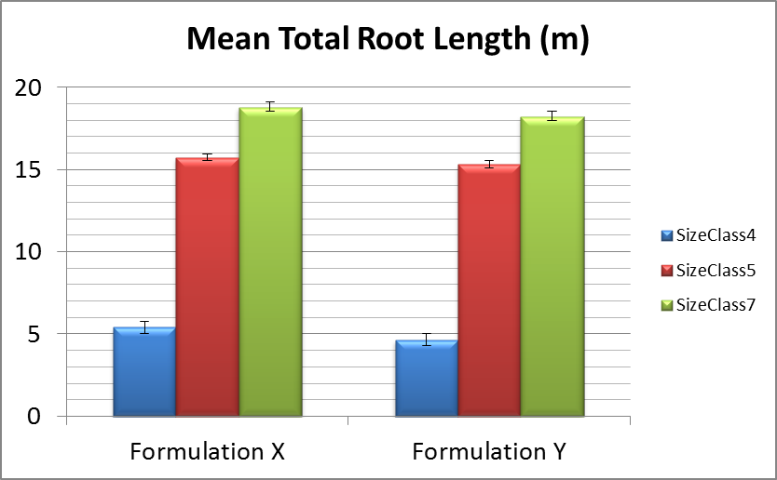
Effect of Microbials on Wheat Seedlings
Formulation X
Formulation Y

Slide 27
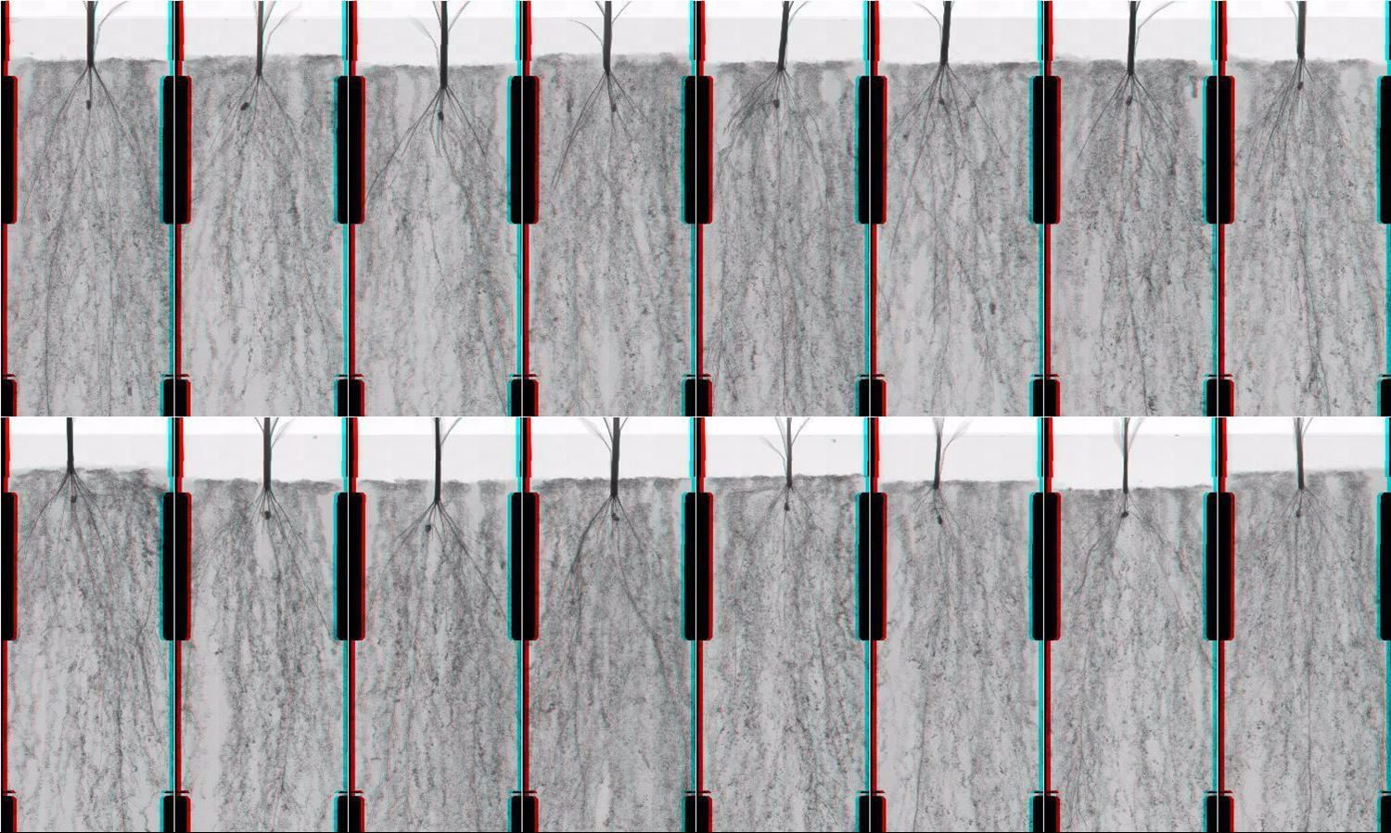
Soft-tissue X-ray Imaging Used to Compare Root Development Over Time
Untreated Treated
Video

Slide 28
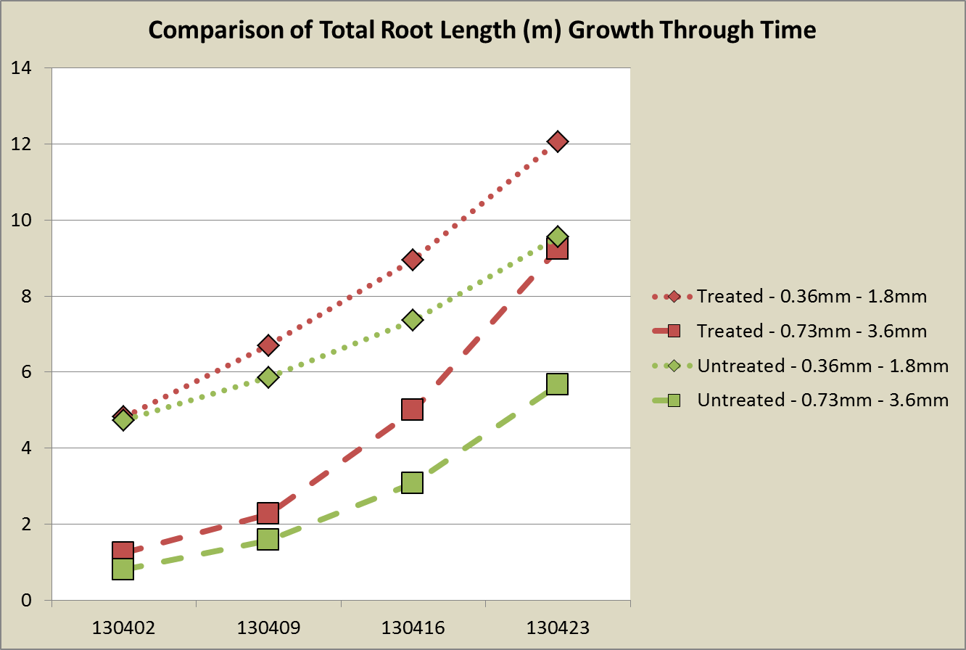
Quantification From X-ray Images to Study Root Development Over Time
Week 3 Week 4 Week 5 Week 6

Slide 29
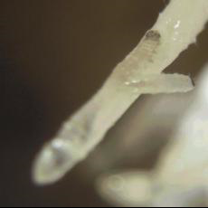
Our Growth Media Is Inert And Falls Away Nicely From Roots
Preserves more fine roots for sampling
Preserves access to clean root tissue for gene expression analysis.
Access to root exudate sampling.
Video

Slide 30
Soft-tissue X-ray Imaging is a Versatile Tool for Plant Root Studies
It is being used to compare:
  High performance germplasm
  Seed treatments
  Effects of microbial communities
  Tillage impacts
  Nematode resistance
  Insect resistance
  Genetic transformations
Let’s put it to use in your research!

