Slide 1

Bridging the gap between single-strain and community-level plant-microbiome chemical interactions
Sarah L. Lebeis, Ph.D.
Department of Microbiology
University of Tennessee
11/7/19
Notes:
Thank you to the organizers for inviting me here today, as well as all of you for coming to listen. I’m excited to talk to you today about the research questions I’ve been able to explore with the help of the PRC, looking at the role of chemotaxis and spatial distribution in microbiome assembly

Slide 2
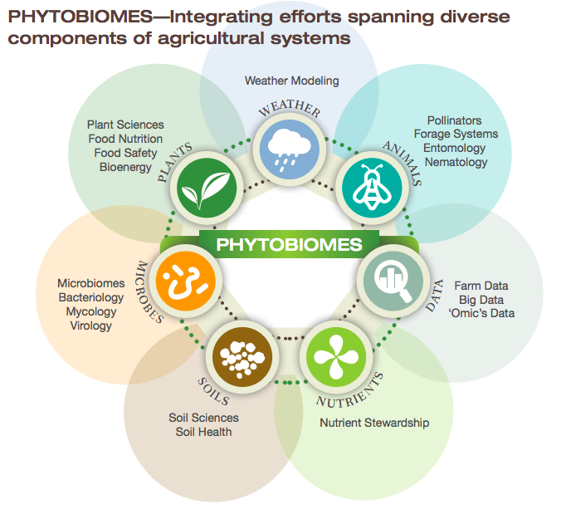
How do plants shape their microbiomes?
What activities do microbes need to colonize plants?
How do microbiomes influence plant health over developmental time?
How can we harness this knowledge?
www.phytobiomes.org

Slide 3
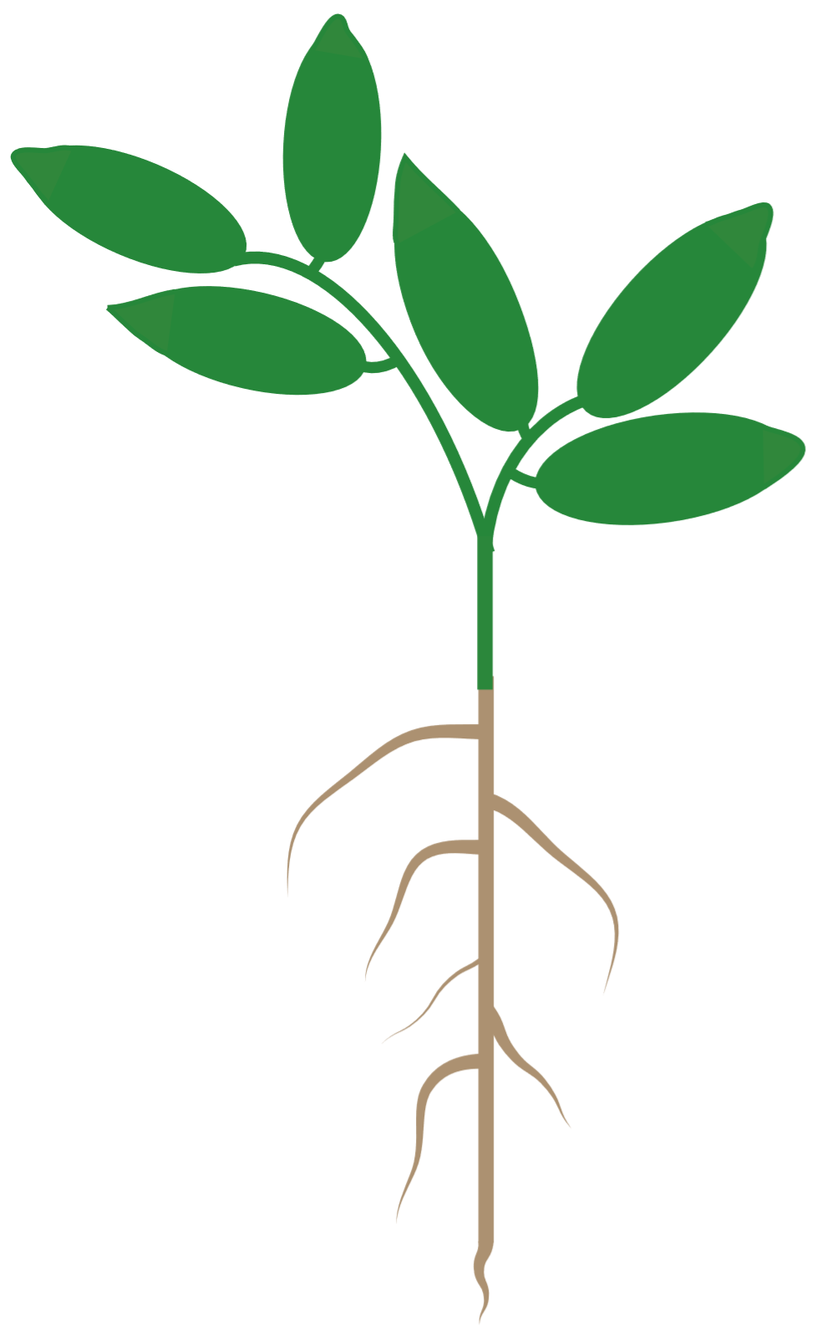
Spatial scales in plant microbiome studies
Modified from O’Banion, et al. 2019
Notes:
But most microbiome work conducted today is done at a scale that we as humans perceive to be relevant. But there is a fundamental disconnect between the scale of our sampling and the scale of the molecular interactions we try to extrapolate to

Slide 4
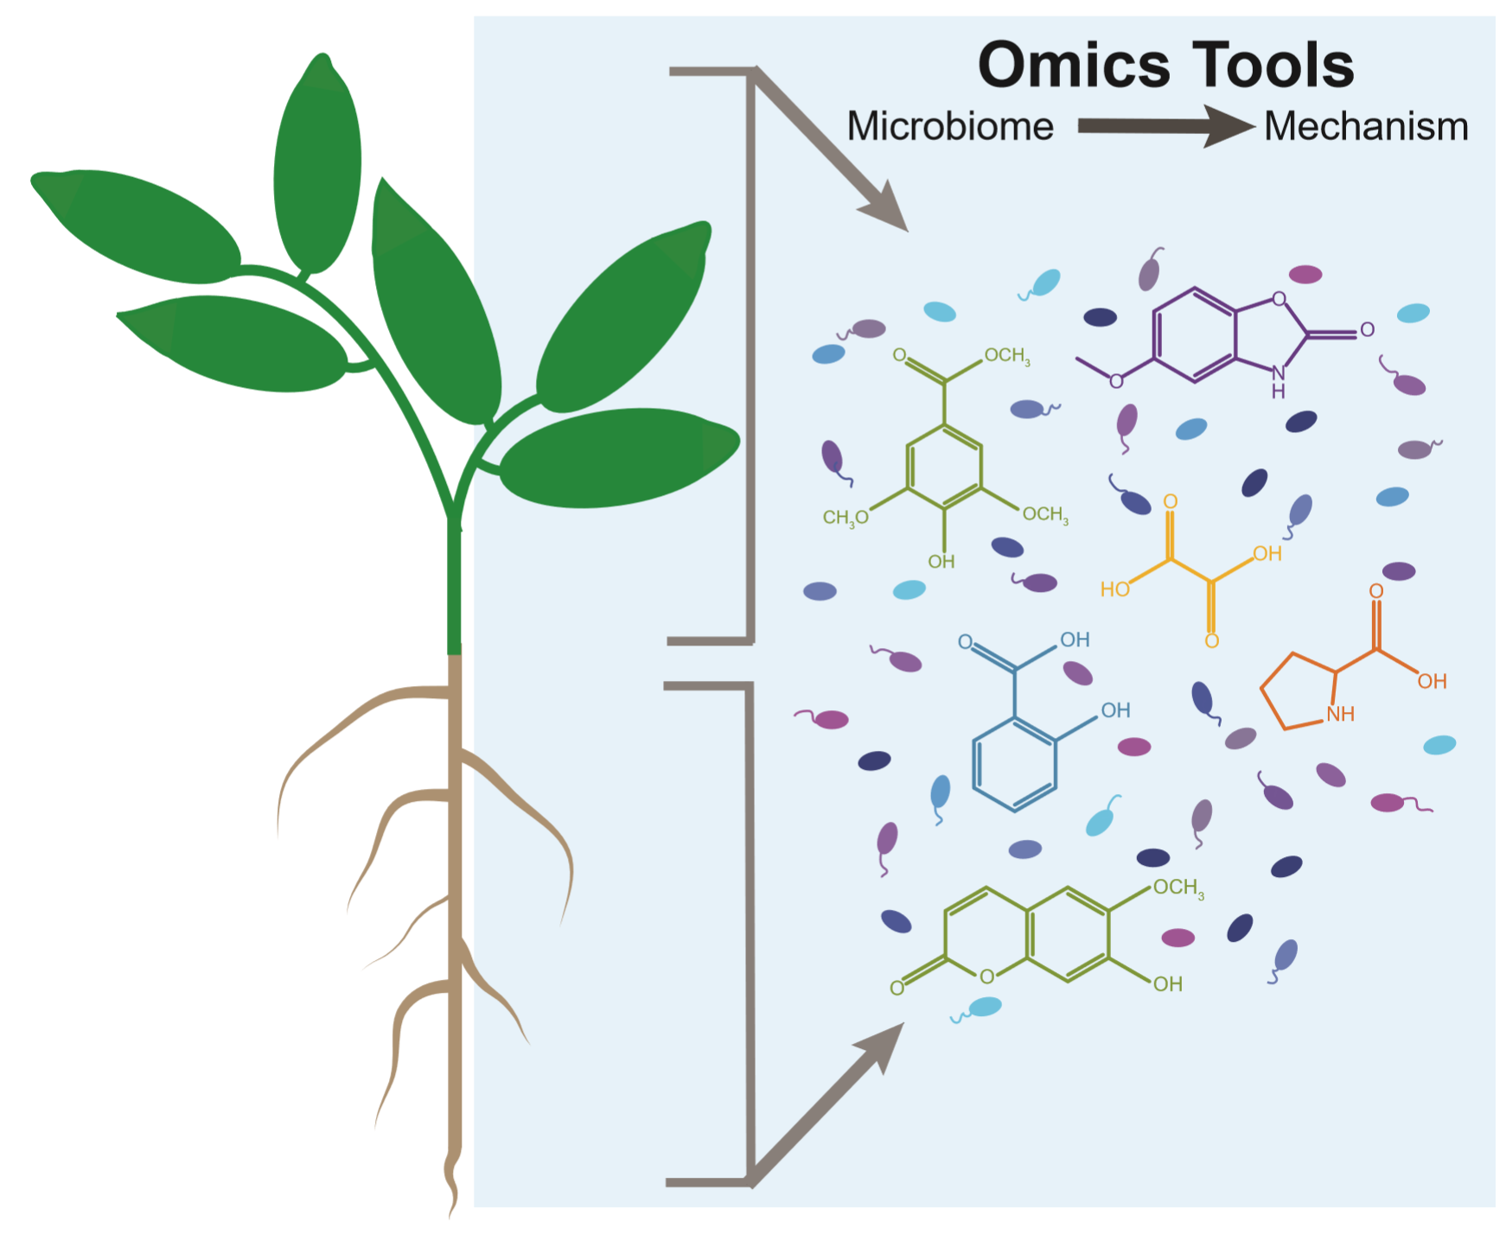
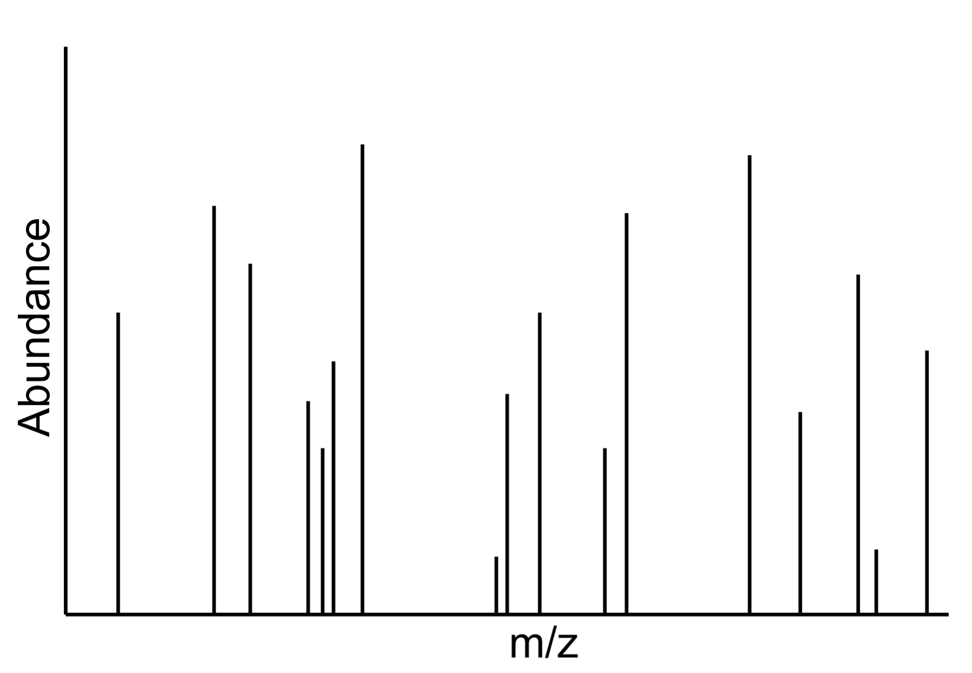
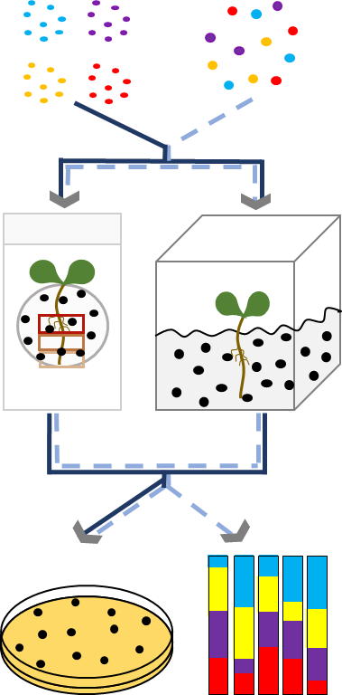
Spatial scales in plant microbiome studies
Modified from O’Banion, et al. 2019
Notes:
We sample plant organs (root or leaf tissue) by taking the entire thing and homogenizing it, then sequencing/analyzing
And while we may see a single homogenous tissue, Microbes likely see a wonderland of different niches, some good and some bad for each specific microbe

Slide 5
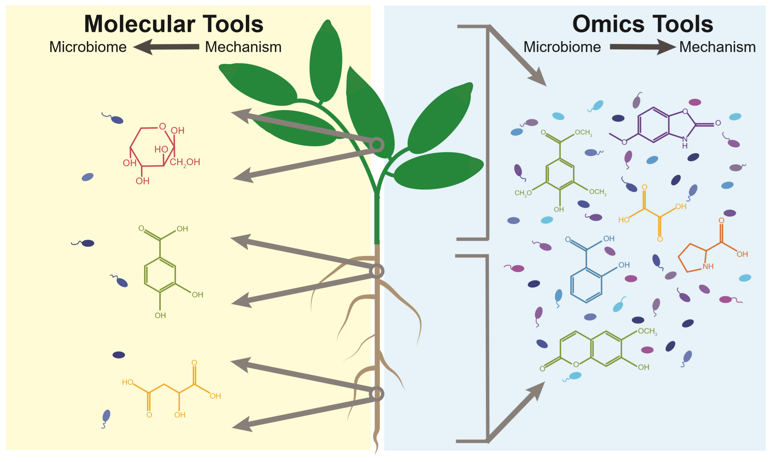
Spatial scales in plant microbiome studies
Modified from O’Banion, et al. 2019
Notes:
And we often study microbial associations with specific parts of the root in the lab by associating single strains with plants. And while studying these binary associations allows us to pin down specific mechanisms at cellular levels, it fails to account for the biotic complexity experienced in wild systems.

Slide 6
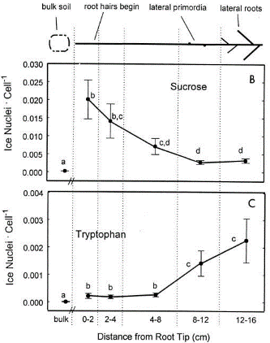
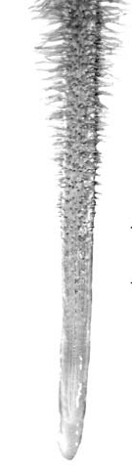
Roots niches are chemically distinct, and microorganisms are sensitive to differences
Root Hair
Elongation Zone
Root Tip
Adapted from Jaeger et al., 1999. Appl Environ Microbiol.
Adapted from O’Neal et al, In review.
Notes:
Some examples for these binary associations from the literature – just a select couple to focus our ideas.
On the left, work from the 90s with ice nucleating bacteria showing differential concentrations for sucrose and tryptophan across the root
On the right, work by our collaborators using chemotaxis mutants to show differential localization
These pieces, along with many other lines of evidence, show us that different root niches are chemically distinct and microorganisms are sensitive to these differences and can localize to the root accordingly.
Make sure to mention that they can be attractants or repellants

Slide 7
Roots niches are chemically distinct, and microorganisms are sensitive to differences
Chemically distinct niches may host different microbial communities.
Root Hair
Elongation Zone
Root Tip
Adapted from Jaeger et al., 1999. Appl Environ Microbiol.
Adapted from O’Neal et al, In review.
Notes:
And if this holds true across more microbes than just the model organisms that have typically been studied in this manner, then chemically distinct niches may host different microbial communities.
Bulk sampling is likely washing out these signals.

Slide 8
Does chemotaxis to specific root niches influence bulk microbiome assembly?
Notes:
So, this has got our lab interested in the following questions. There are a lot of other factors in addition to localization that likely influence colonization (C source, competition, immune suppression, etc.)
Chemotaxis towards or away from root niches

Slide 9
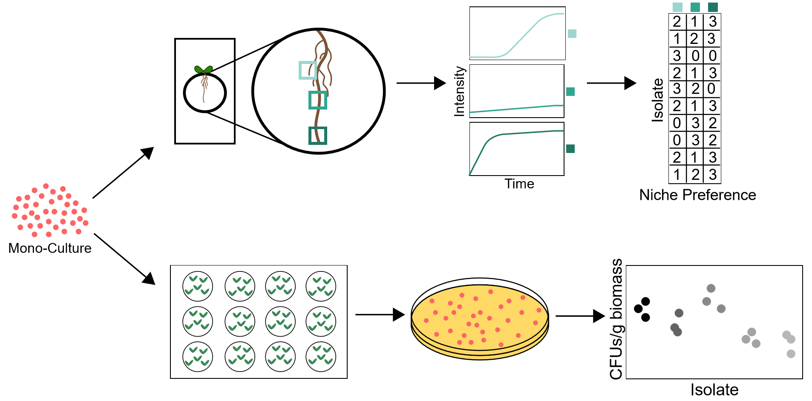
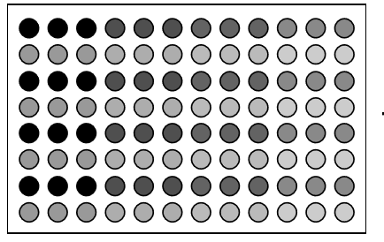
Our approach
Characterize the fundamental niche of isolates in vitro and in vivo
Use functional information to build synthetic communities and investigate phenotypes of interest
Notes:
Our approach involves first gathering a collection of isolates relevant to the phytobiome (based on 16S sequencing data) with fully sequenced genomes. then putting each of these isolates through a variety of characterizations in vitro and in vivo. Based on these functions, we will combine them into a variety of synthetic communities and investigate different outcomes. We want to characterize each organism in isolation first – how do we know what changes in a community context if we don’t have baseline info?
Most of what I’ve done the past year = choosing isolates, extracting gDNA, isolate phenotypic characterizations. = Building a foundation to move forward, combining into groups or picking interesting phenotypes to investigate further for the remainder of my dissertation

Slide 10
Characterize the fundamental niche of isolates in vitro and in vivo
Part I: Select motile isolates
Part II: Extract gDNA and submit for whole-genome sequencing
Part III: Initial root chemotaxis and 2 week colonization
Part IV: in vitro carbon utilization
Notes:
Majority of the past year has been spent building this foundation

Slide 11

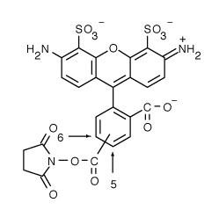
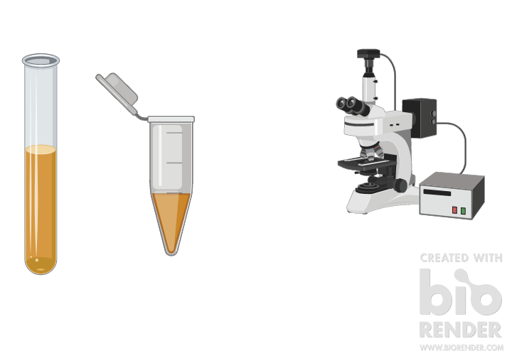

Fluorescent dyes for live staining cells
Alexa Fluor NHS ester
Grow culture
Wash cells
Wash cells
Associate bacterial cells with plant root
Track with fluorescence microscopy
Notes:
Use amine reactive fluorescent dyes (binds to OM and lipopolysaccharides), wash to remove free dye, suspend on slide with plant (we used Arabidopsis) and visualize after about 4 hours.
This method allows us to expand our knowledge of where strains go. Historically this has only been done with genetically tagged organisms, but this allows us to bypass this step

Slide 12
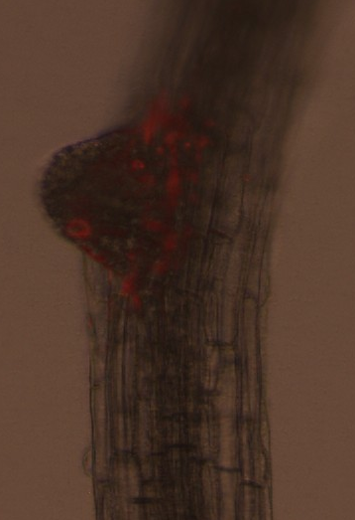
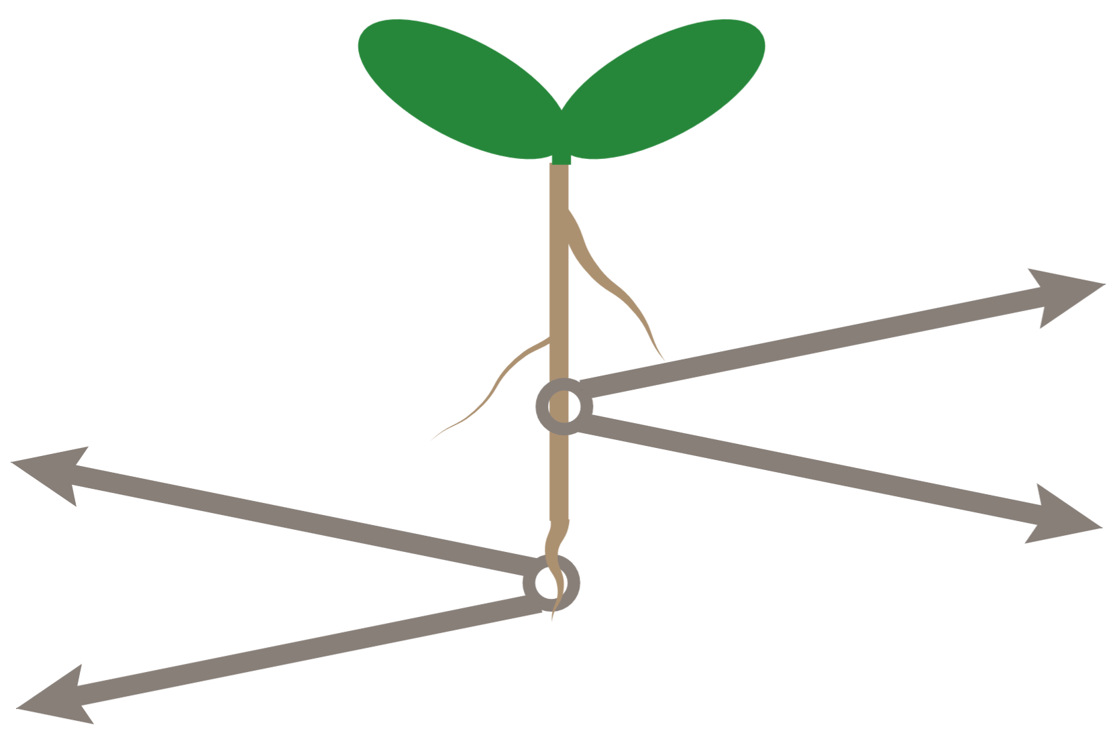
Dyella japonica UNC79MFTsu3.2
Enterobacter sp. 71
400 um
Elongation Zone
Emerging Lateral Root
Notes:
Some examples of what we have. On the right, Dyella in red, a gamma, localizing to elongation zone (just above root tip), and on the left, P. fluorescens in green, which has been used for a model organism in other types of studies but never in this manner, localizing to root hairs.

Slide 13
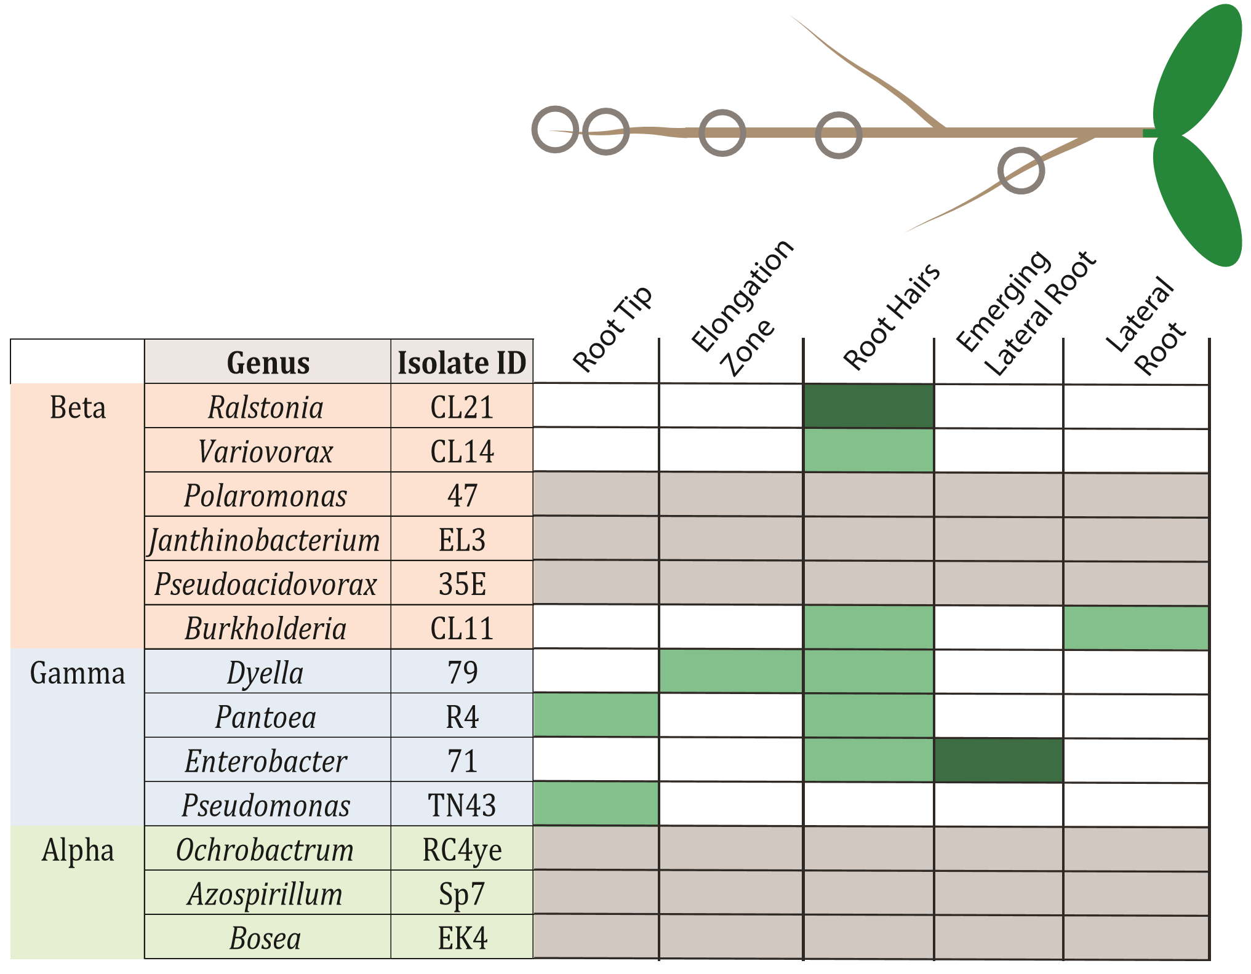
Notes:
But lets focus on one characterization most relevant to the topic of this talk: spatial localization.
Typically done with model systems using fluorescent protein tags or FISH. But most microbiome bugs are not represented by model organisms and wild isolates often not genetically tractable (atleast when thinking of 20 isolates within the timeframe of a PhD). And FISH requires fixed samples.

Slide 14
Bulk seedling colonization
Notes:
But lets focus on one characterization most relevant to the topic of this talk: spatial localization.
Typically done with model systems using fluorescent protein tags or FISH. But most microbiome bugs are not represented by model organisms and wild isolates often not genetically tractable (atleast when thinking of 20 isolates within the timeframe of a PhD). And FISH requires fixed samples.

Slide 15
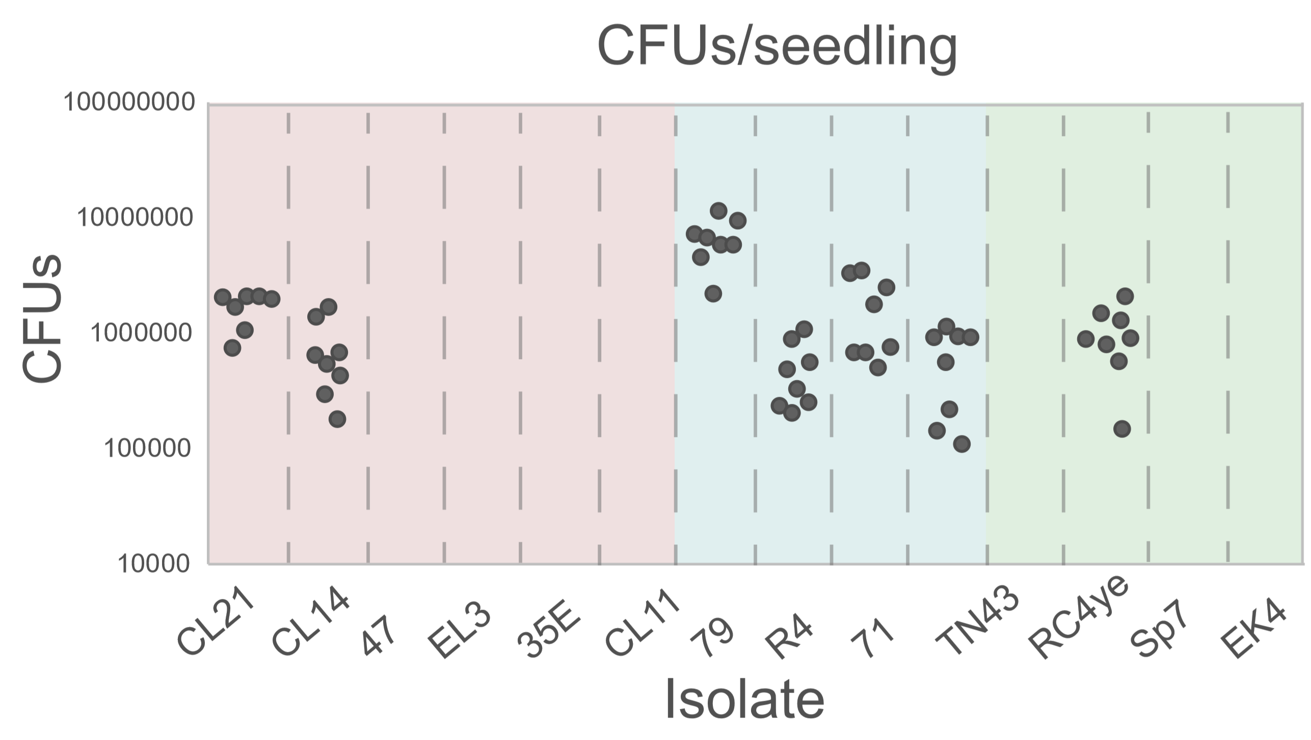
Bulk seedling colonization
Beta
Gamma
Alpha
Notes:
But lets focus on one characterization most relevant to the topic of this talk: spatial localization.
Typically done with model systems using fluorescent protein tags or FISH. But most microbiome bugs are not represented by model organisms and wild isolates often not genetically tractable (atleast when thinking of 20 isolates within the timeframe of a PhD). And FISH requires fixed samples.

Slide 16
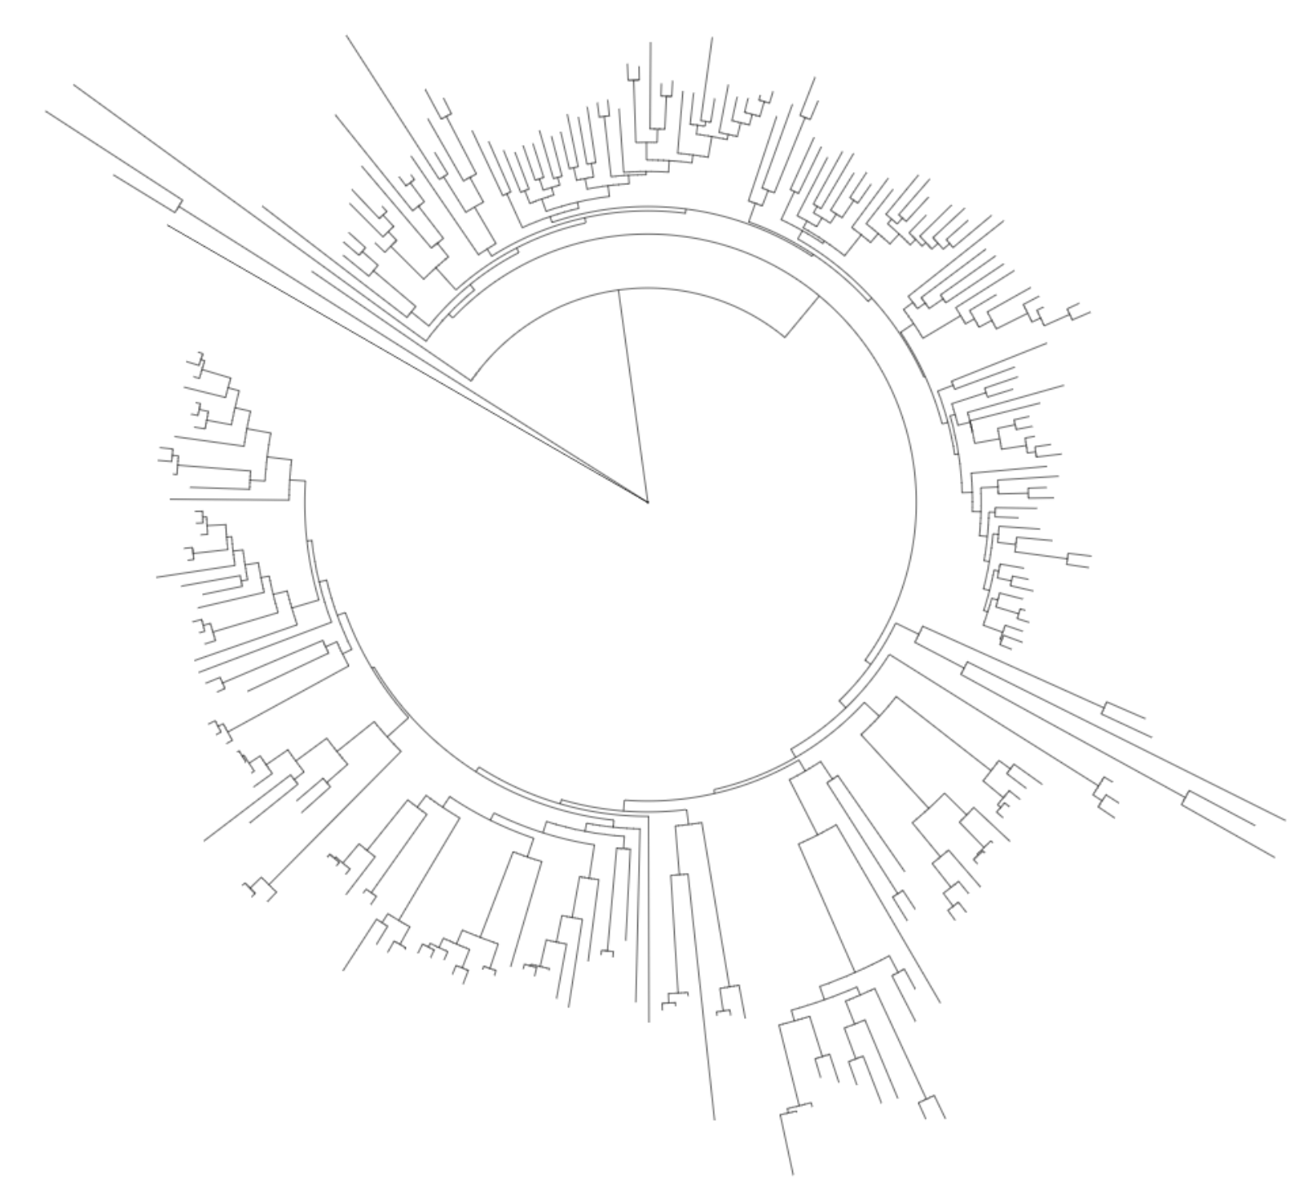
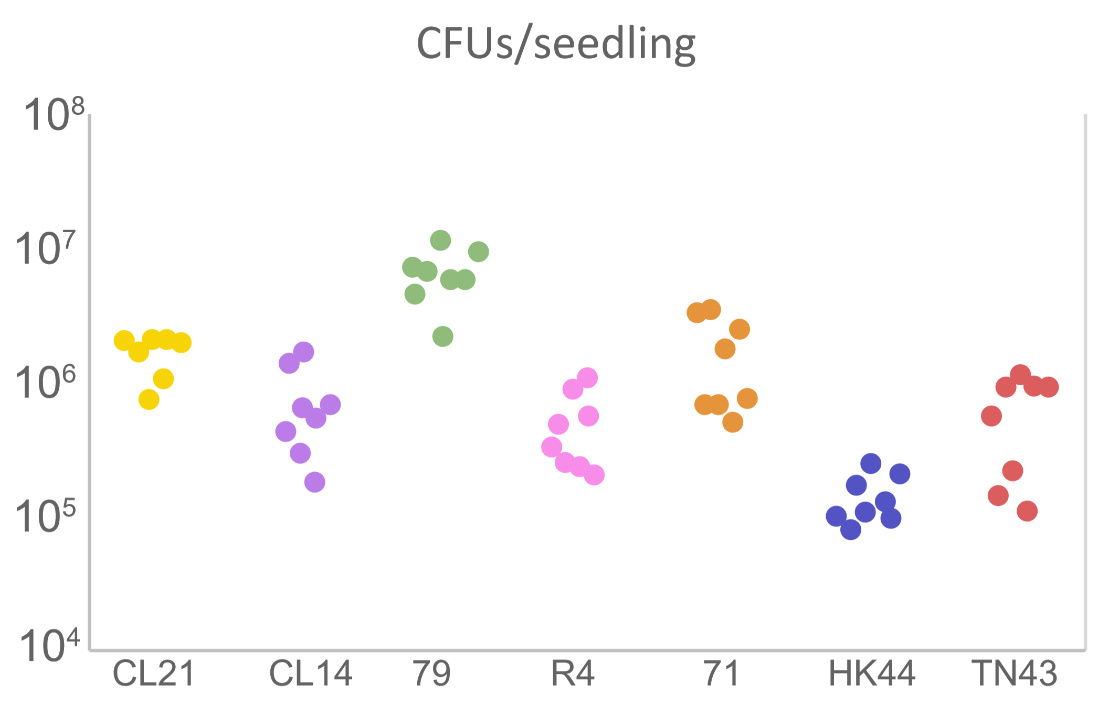
Future work:
Notes:
Normalize to cheA copies, clean up tree a little bit (or remove)

Slide 17
Biolog Plates
Grow cells in LB
Wash 3x in 1x PBS
Resuspend to an OD 0.01 in ¼ MS (no carbon source)
Measure color change over time
Notes:
Go through list of characterizations.
Altogether, these different analyses can give us an idea of their mono-interactions with the plant, as well as their potential niche overlap and antagonistic behavior they may have with other organisms

Slide 18
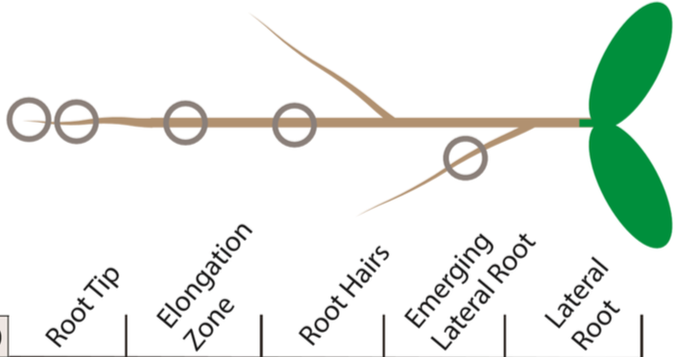
Predicted carbon utilization
Carbs
Acids
AA
Amine/
Amide
Notes:
Go through list of characterizations.
Altogether, these different analyses can give us an idea of their mono-interactions with the plant, as well as their potential niche overlap and antagonistic behavior they may have with other organisms

Slide 19
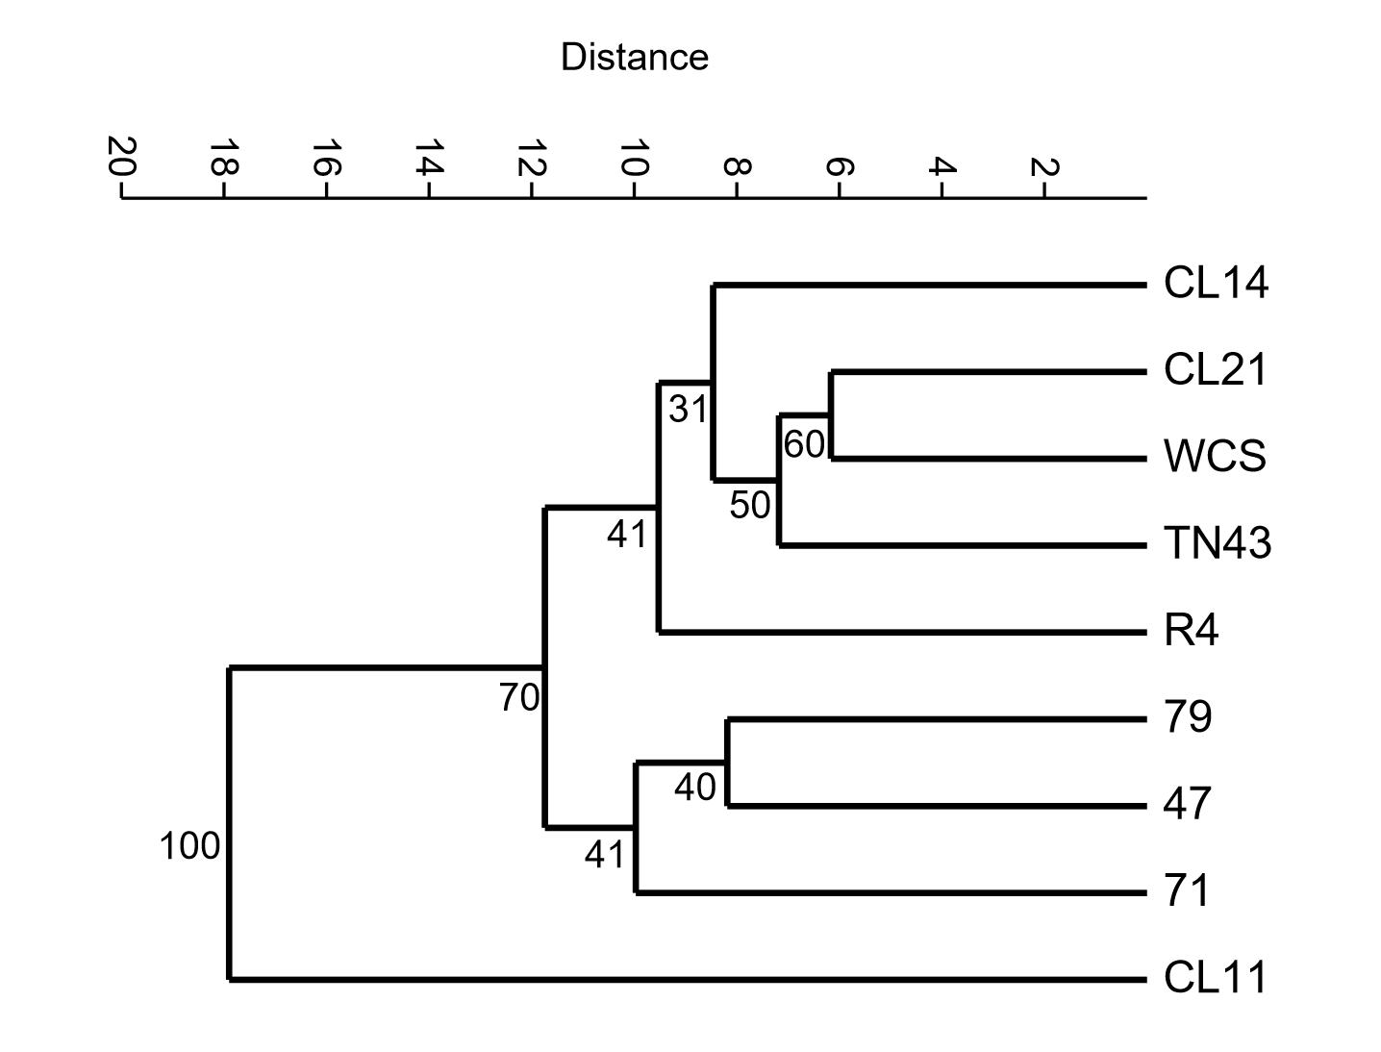
dbCAN Profile clustering
Database of Carbohydrate-active enzymes
Notes:
100s of dbCAN entries – other thoughts on ways to represent?

Slide 20
Future Baseline Work
  In silico characterizations
    Chemotaxis receptor repertoires
    Carbohydrate-active enzymes
    Secondary metabolite biosynthesis
  Create synthetic communities of isolates
Notes:
Go through list of characterizations.
Altogether, these different analyses can give us an idea of their mono-interactions with the plant, as well as their potential niche overlap and antagonistic behavior they may have with other organisms

Slide 21
Our approach
Characterize the fundamental niche of isolates in vitro and in vivo
Use functional information to build synthetic communities and investigate phenotypes of interest
Notes:
Our approach involves first gathering a collection of isolates relevant to the phytobiome (based on 16S sequencing data) with fully sequenced genomes. then putting each of these isolates through a variety of characterizations in vitro and in vivo. Based on these functions, we will combine them into a variety of synthetic communities and investigate different outcomes. We want to characterize each organism in isolation first – how do we know what changes in a community context if we don’t have baseline info?
Most of what I’ve done the past year = choosing isolates, extracting gDNA, isolate phenotypic characterizations. = Building a foundation to move forward, combining into groups or picking interesting phenotypes to investigate further for the remainder of my dissertation

Slide 22
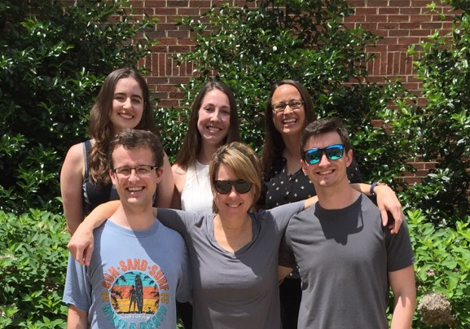






Acknowledgements
Collaborators
Gladys Alexandre (UTK)*
Alex Buerkle (U of Wyom.)
Jeff Dangl (UNC) *
Matt Forister (U of Nevada)
Jim Fordyce (UTK)
Zach Gompert (Utah St. U)
Eric Lam (Rutgers U)
Lauren Lucas (Utah St. U)
Meg Staton (UTIA)
Lebeis Lab
Graduate Students:
Alexandra Gates
David Grant
Katherine Moccia
Bridget O’Banion*
Lebeis Lab support
Former members:
Sarah Stuart Chewning
Lizzy Denison*
Virginia Hargest
Jake Massey
Kathleen McGuire
Andrew Willems
Notes:
EMSL logo

